Slide 1



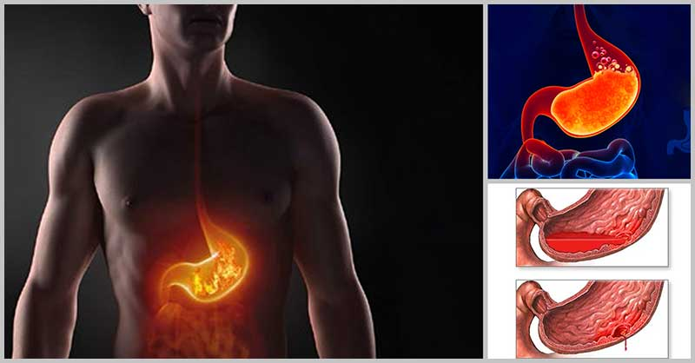
HYPER ACIDITY

Slide 2



AGENDA
Introduction
Pathophysiology
Major Causes
Common Symptons
5. Diagnosis
6. Treatment Plan
7. Conclusion

Slide 3
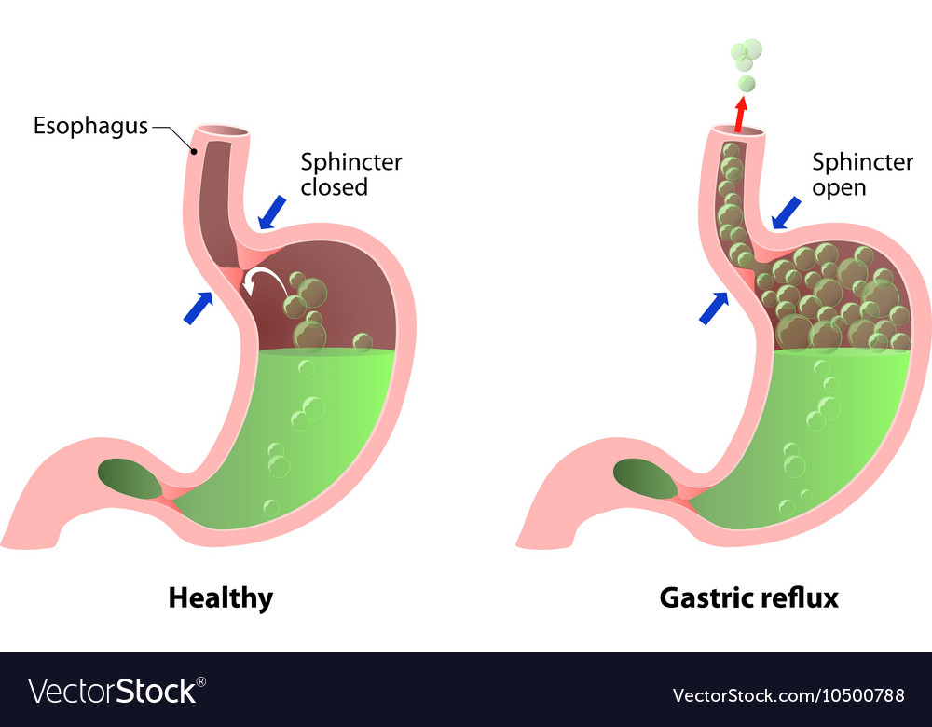
What is Hyperacidity?
In Ayurveda, Hyperacidity is called Amlapitta
Excess hydrochloric acid secretion in the stomach
Damages the protective mucosal lining
Causes irritation, inflammation, or ulcers
Common in adults with poor dietary habits

Slide 4

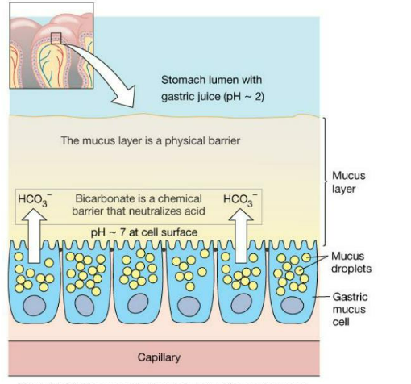

PATHOPHYSIOLOGY
The mucosal lining of the stomach normally protects it from the action of gastric acid. The mucosal barrier is composed of prostaglandins
Due to any cause
This barrier get penetrated
HCL comes in contact with mucosa
Inflammation to the lining
Edema, Haemorrhage & possible Ulcer formation

Slide 5
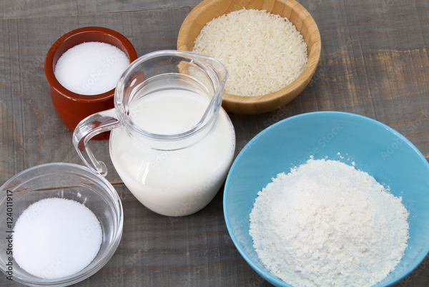

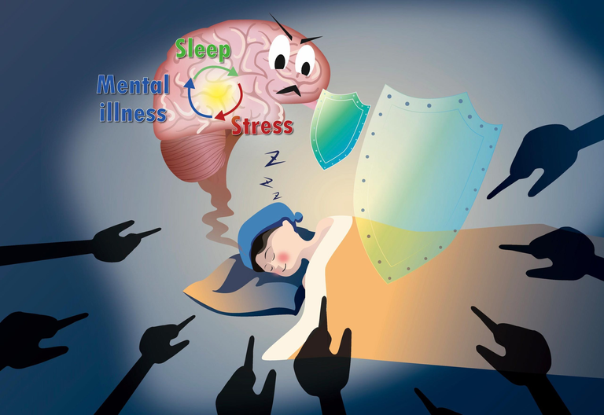
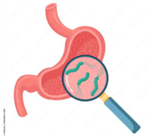
Major Causes
Dietary Triggers
Foods incompatible with constitution; avoid mixing milk with fish or salt, excessive sour/spicy foods, white flour, and sugar products.
Unhealthy Habits
Smoking, heavy tea/coffee/alcohol intake, eating during indigestion, and suppressing urination or stool urges.
Sleep & Stress Factors
Daytime sleep post-meals, late nights, excessive stress, anger, hunger, and overexposure to sun or heat.
Medical Condition
Gastro duodenal ulcers contribute to digestive discomfort and require medical attention.

Slide 6
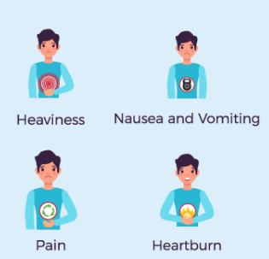
Common Symptoms
Restlessness & Discomfort
A persistent unsettled feeling often signals stomach irritation.
Nausea & Vomiting
Feeling queasy or actual vomiting may accompany acid buildup.
Sour Belching
Belching with a sour taste, sometimes of previously eaten food.
Stomach Stiffness
Sensation of tightness or discomfort in the stomach area.
Loss of Appetite
Decreased desire to eat, often linked to digestive discomfort.
Indigestion
Difficulty digesting food, causing bloating and discomfort.
Constipation
Irregular or difficult bowel movements related to digestive issues.

Slide 7

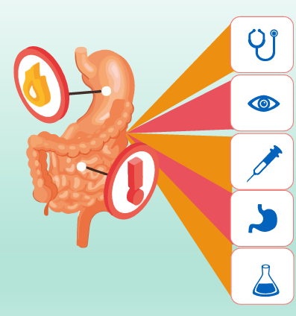

DIAGNOSIS
Clinical Examination
Gastroscopy
(Upper Gastrointestinal Endoscopy)
Gastrin Levels in Blood Test
Occult Stool Test
Serology & Histology for H. Pylori
Ba Meal x-ray
Biopsy

Slide 8



TREATMENT PLAN
Medical Management
Preventive Management

Slide 9



MEDICAL MANAGEMENT
1
2
Proton Pump
Inhibitors
H2 Antagonists
3
4
Antibiotics
Antacids

Slide 10

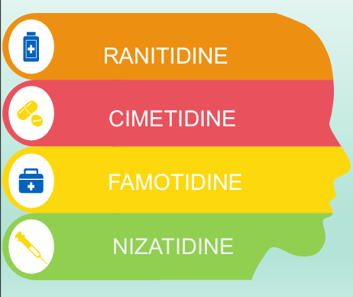
H2 Antagonists
Suffix
-tidine
MOA
H2 antagonists block the H2 receptors in the parietal cells of the stomach and decrease the gastric acid secreation
Adverse Effects
Diarrhoea
Dizziness
Headache

Slide 11


Slide 12
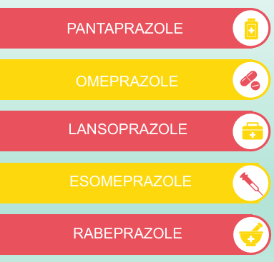
PROTON PUMP
INHIBITORS
Suffix
-prazole
MOA
PPI’s effectively block gastric acid secreation by irreversibly binding to and inhibiting the H+/K+ ATPase pump that resides on the luminal surface of the parietal cell membrane.
Adverse Effects
Nausea
Headache
Constipation

Slide 13
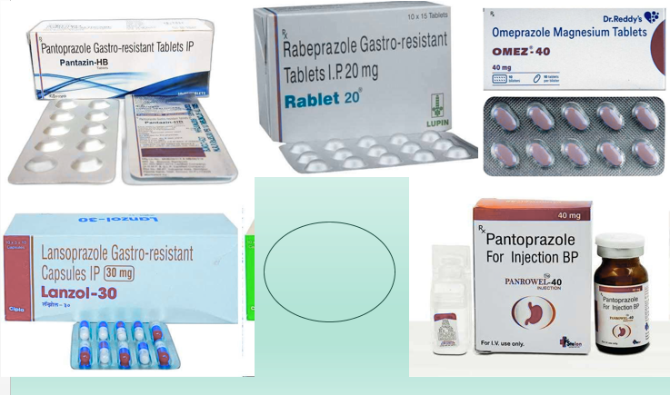

Slide 14

Antibiotics
Antacids
•Sodium
Bicarbonate
•Aluminum
Hydroxide
•Magnesium
Hydroxide
•Calcium
Carbonate
These are inorganic salts acts by direct chemical neutralization of HCL & decrese the pepsin activity
•Amoxycillin
•Clarithromycin
•Metronidazole
•tetracycline
Antibiotics are used to kill the H pylori bacteria

Slide 15
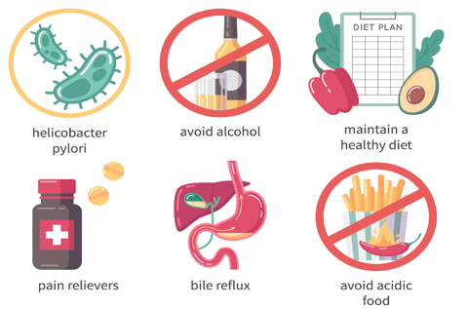
PREVENTIVE MANAGEMENT
Do’s
•Follow the meal times.
•Light food, Coconut water, articles having cooling properties.
•Seasonal vegetables of bitter taste.
•Seasonal Fruits like gooseberry, dry grapes, black grapes, sweet lime, pomegranate, fig, dry fig.
•Ushir, laja, Dadimaka preparation
•Take adequate amount of fluids.
•Take warm water.
•A cup of lukewarm milk after every two or three hours.
•Practice Yoga, Pranayama, meditation & exercise regularly

Slide 16
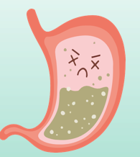
PREVENTIVE MANAGEMENT
•Avoid excessive spicy, sour, salty food items
•Avoid fried & junk food items
•Do not remain hungry all the time
•Do not over eat
•Avoid food containing excessive amount of garlic, chilli, salt, oil very often
•Avoid rice, curd, sour fruits
•Avoid bakery items, fermented foods like bread, pickles, maida etc
•Avoid lying down in supine position (best position is left lateral)
•Avoid smoking, alcohol, tea, coffee, aspirin drugs etc
•Avoid stress, anger
Dont’s

Slide 17
Conclusion
Hyperacidity is common and usually lifestyle-related
Diagnosis is straightforward with endoscopy and H. pylori tests
Treatment includes PPIs, H2 blockers, and eradication therapy
Prevention is best achieved via diet, sleep, and stress management

Slide 18




Thank You

